Slide 1

Average Power Based EEG Channel Selection Method for Emotion Recognition
Team No 05
ID: 22366021
Name: Nadia Tasnim Mim
ST: Farhadul
RA: Mehedi

Slide 2
Agenda
Introduction
Objectives
Methods
Results
Implications
Discussion
Conclusion

Slide 3
Introduction
Introduction
Objectives
Methods
Results
Implications
Discussion
Conclusion
Appropriate emotion recognition has a great impact to make the machines adaptable to humans’ emotional state and user-friendly in real time.
Along with the change of emotion, EEG signals quickly capture or respond to the changes as it is generated from CNS.
Electroencephalogram (EEG) signals are also more insightful especially when any subject can not express his/her desired emotion.
EEG channel selection techniques and feature extraction methods are important factors in increasing the accuracy rate as well as reducing space and time complexity.

Slide 4
Objectives
Introduction
Objectives
Methods
Results
Implications
Discussion
Conclusion
To observe the performance of Root Sum Square(RSS) in DWT based feature reduction process.
Using average power of EEG signals in the EEG channel selection process.
Reducing space, time and computational complexity by using selective channels.
Locating brain areas responsible for emotion generation.

Slide 5
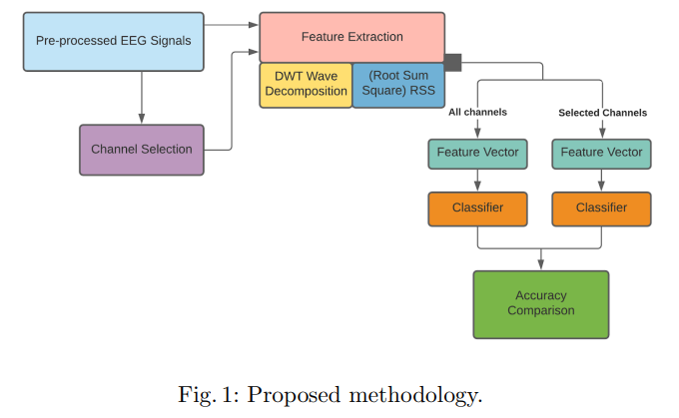
Proposed Methodology
Introduction
Objectives
Methods
Results
Implications
Discussion
Conclusion

Slide 6
Dataset Pre-processing
Introduction
Objectives
Methods
Results
Implications
Discussion
Conclusion
Valence and arousal target labels are classified as high(1) and low(0) class.
Ratings are in range of 1 to 9.
A threshold value of 5 is considered to classify the data in high and low class.
Total number of high and low class in valence is 724 and 556.
Total number of high and low class in arousal is 754 and 526.

Slide 7
Feature Extraction
Introduction
Objectives
Methods
Results
Implications
Discussion
Conclusion
DWT multilevel decomposition is used to get four levels of detailed coefficients which are cD1, cD2, cD3 and cD4.
A statistical method named Root Sum Square (RSS) is used to reduce the dimension of the coefficients.
For generating more information:
a) RSS ratio of cD1 and cD2 is used.
b) RSS ratio of cD3 and cD4 is used.
c) RSS absolute difference between cD1 and cD2 is used.
d) RSS absolute difference between cD3 and cD4 is used.
Feature Dimension:
a) For 32 EEG channels: 8x32x40 (features x channels x videos)
b) For 10 selected EEG channels: 40x80 (videos/trials x features)

Slide 8
Classification
Introduction
Objectives
Methods
Results
Implications
Discussion
Conclusion
Four machine learning algorithms are used:
Random Forest(RF)
Naive Bayes(NB)
Multi-layer Perceptron(MLP)
Extra Trees(ET)
Hyper parameter tuning is done for achieving a standard non-bias accuracy.
80 percent of the data has been used to train the model and the rest of the data has been deployed to test the performance.
Performance metrics like test accuracy, precision, recall and f1-score for each of the algorithm are measured.

Slide 9
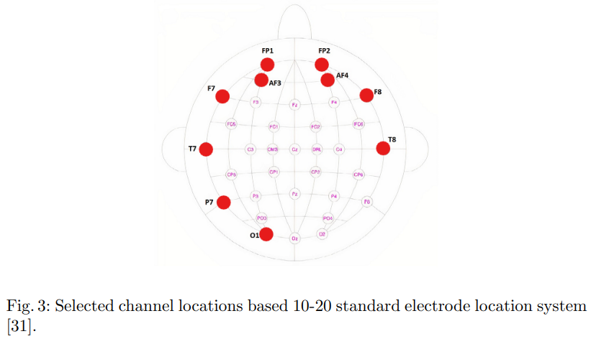
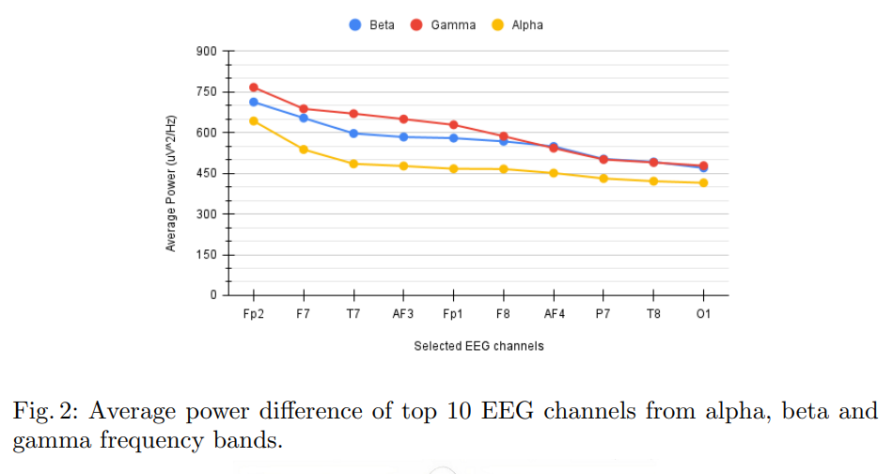
Insight From Channel Selection
The selected channels are located in the prefrontal, occipital, temporal and posterior lobe which are important locations of the brain in terms of emotion generation.
Introduction
Objectives
Methods
Results
Implications
Discussion
Conclusion
The average power of top 10 EEG channels of alpha band is less than beta and gamma band.

Slide 10
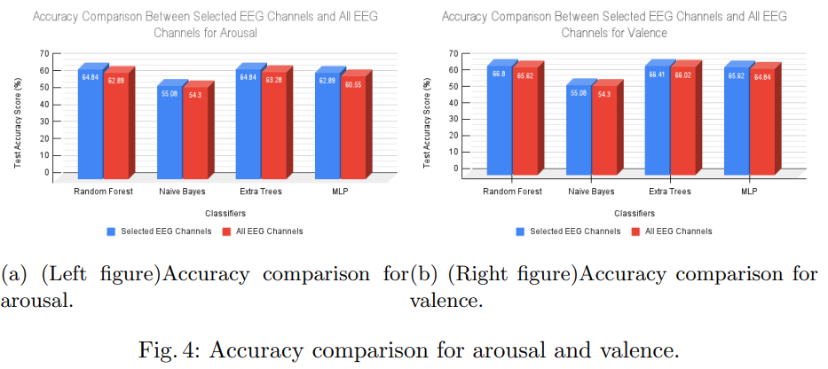
Test Accuracy Comparison
Introduction
Objectives
Methods
Results
Implications
Discussion
Conclusion

Slide 11
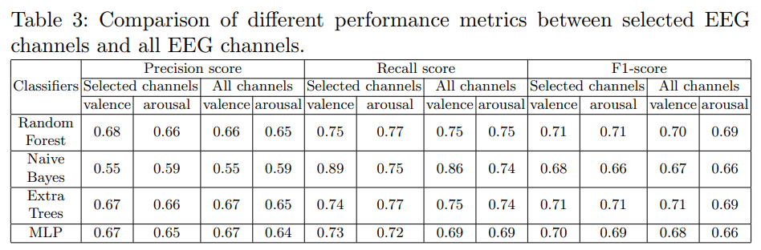
Performance Metrics Comparison
Introduction
Objectives
Methods
Results
Implications
Discussion
Conclusion

Slide 12
Implications
Introduction
Objectives
Methods
Results
Implications
Discussion
Conclusion
Emotion recognition can help to improve BCI based systems.
It is very useful when a person is unable to speak and move.
Different dataset can be used to observe the performance in the proposed methodology.

Slide 13
Discussion
Introduction
Objectives
Methods
Results
Implications
Discussion
Conclusion
With average power based EEG channel selection technique, important channels in terms of emotion recognition can be selected.
The time, space and computational complexity can be reduced by using Root Sum Square(RSS) to reduce feature dimension of DWT.
The accuracy of the classifiers can be increased by extracting better features or better hyper-parameter tuning.

Slide 14
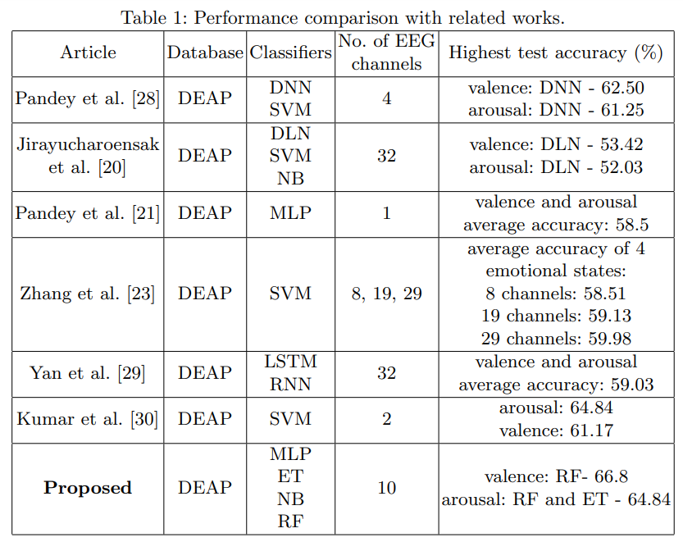
Discussion (cont.) Performance Comparison With Related Works
Introduction
Objectives
Methods
Results
Implications
Discussion
Conclusion

Slide 15
Conclusion
Introduction
Objectives
Methods
Results
Implications
Discussion
Conclusion
The performance improvement is measured with all 32 EEG channels and selected 10 EEG channels.
Both the training time and memory space are saved as well as performance can be enhanced with selected channels.
The validation of this study is found while comparing with some recent works on DEAP database.
Using Root Sum Square(RSS) features to reduce the dimension of DWT vectors of different frequency bands and average power based channel selection algorithm make this research work unique.
As some instances are wrongly classified for both valence and arousal, better machine learning algorithms, channel selection techniques or methodology can be used.

